Slide 1

& Data Analysis
Shoes Classification

Slide 2
Contents
Introduction
Objective
Problem / solving
Visualization
Insights
Conclusion

Slide 3
Introduction
Today, we are excited to present a detailed analysis of the shoes derived from a collective dataset.
Extracting meaningful and valuable insights from raw data to help the client with better understanding.

Slide 4
Objective
Data Collecting & Cleaning
Visualization
Customer Understanding
Prediction and Forecasting
Deep Analysis

Slide 5
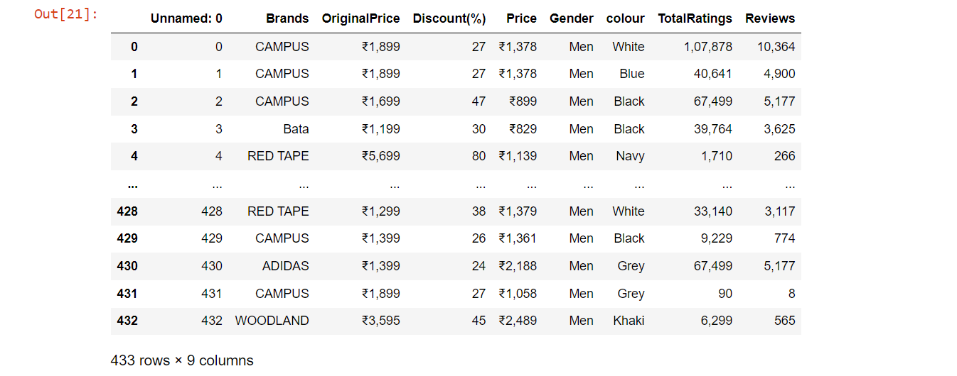
Raw DataFrame

Slide 6
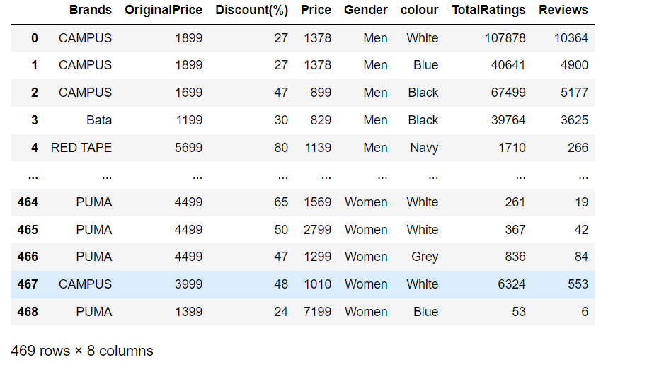
Final DataFrame

Slide 7
Problem & Solving
Client Enquiry : Hey, I’m interest in initiating a business venture and am seeking assistance in obtaining detailed data related to the footwear industry.
Solution : Helping the client's requirements through a comprehensive data analysis approach, coupled with strategic visualization techniques, to deliver actionable insights and support informed decision-making.

Slide 8
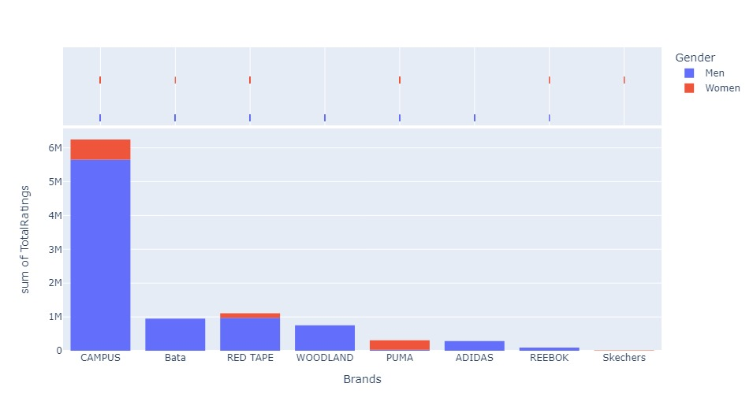
Visualization
Sum of Total Ratings given by men and women for Different Brands.

Slide 9
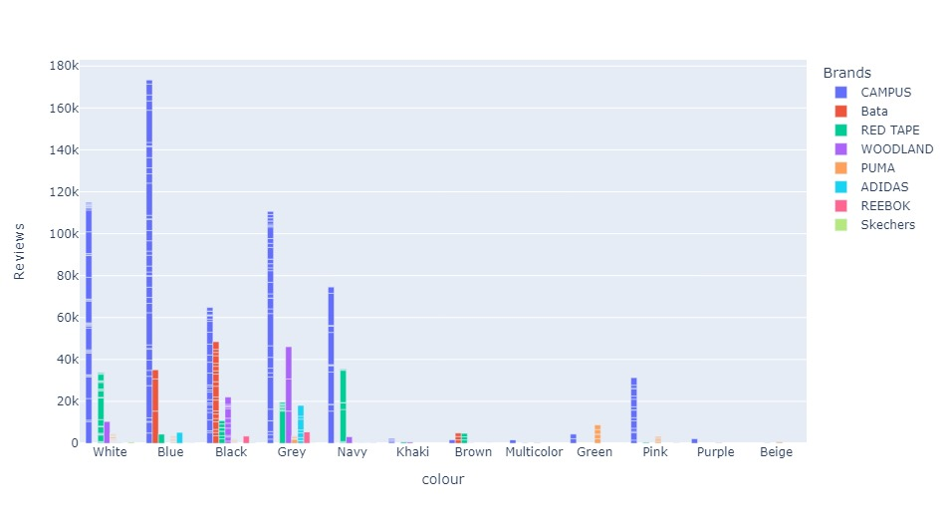
Total number of reviews for different coloured shoes in all brands

Slide 10
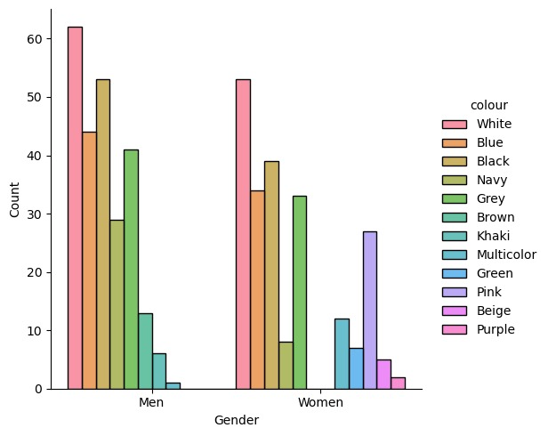
Total count of each coloured shoes for both men & women in all brands

Slide 11
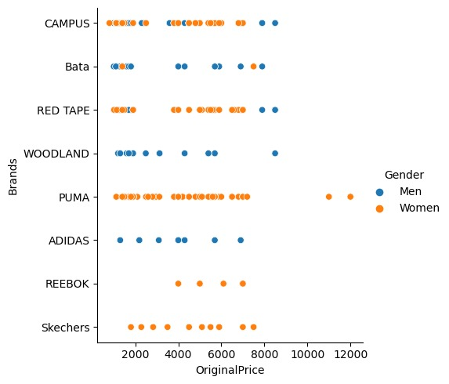
Original prices of different brands for men & women

Slide 12
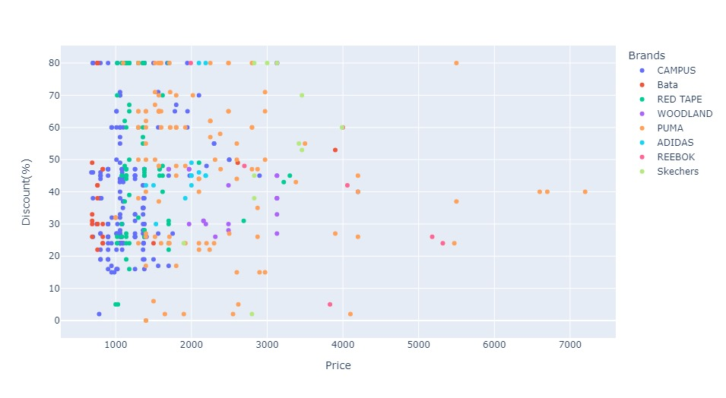
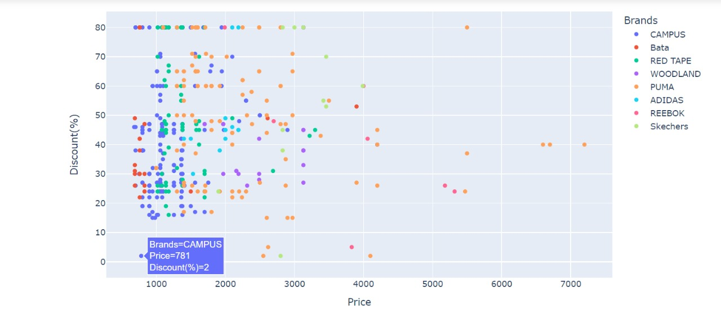
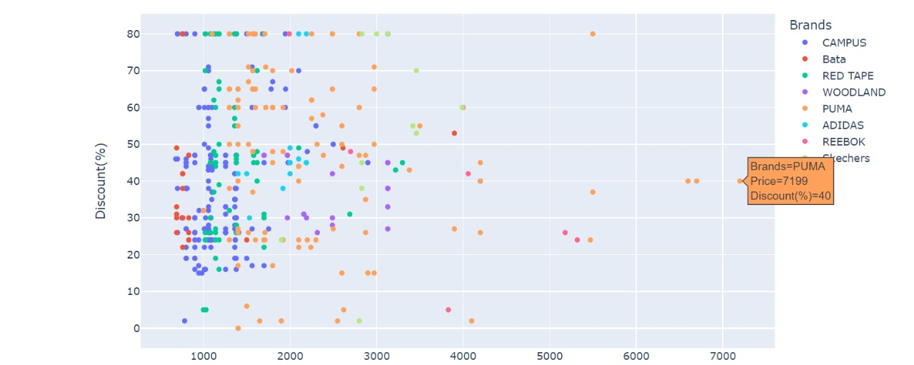
Discount over price for Different Brands

Slide 13
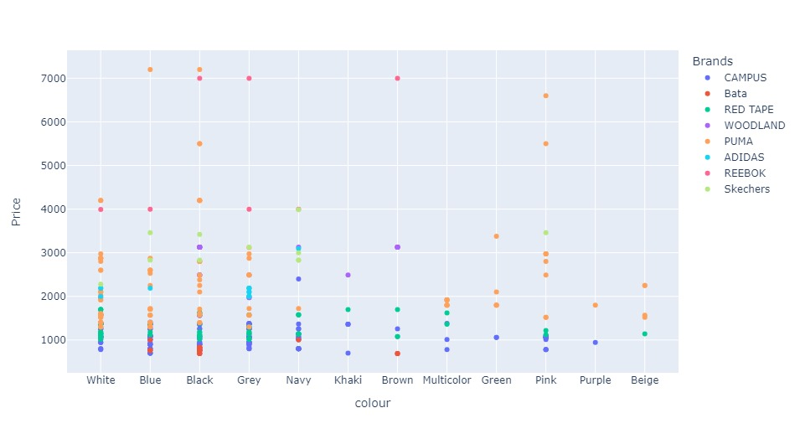
Prices for different coloured shoes in all Brands

Slide 14
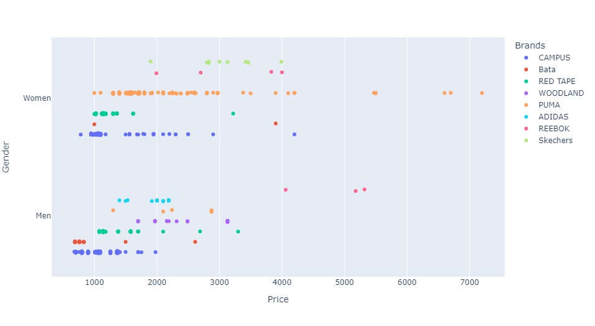
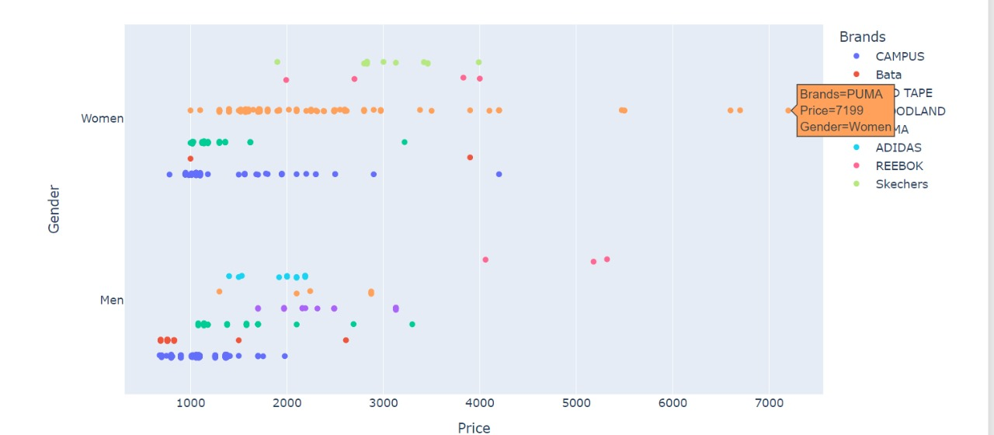
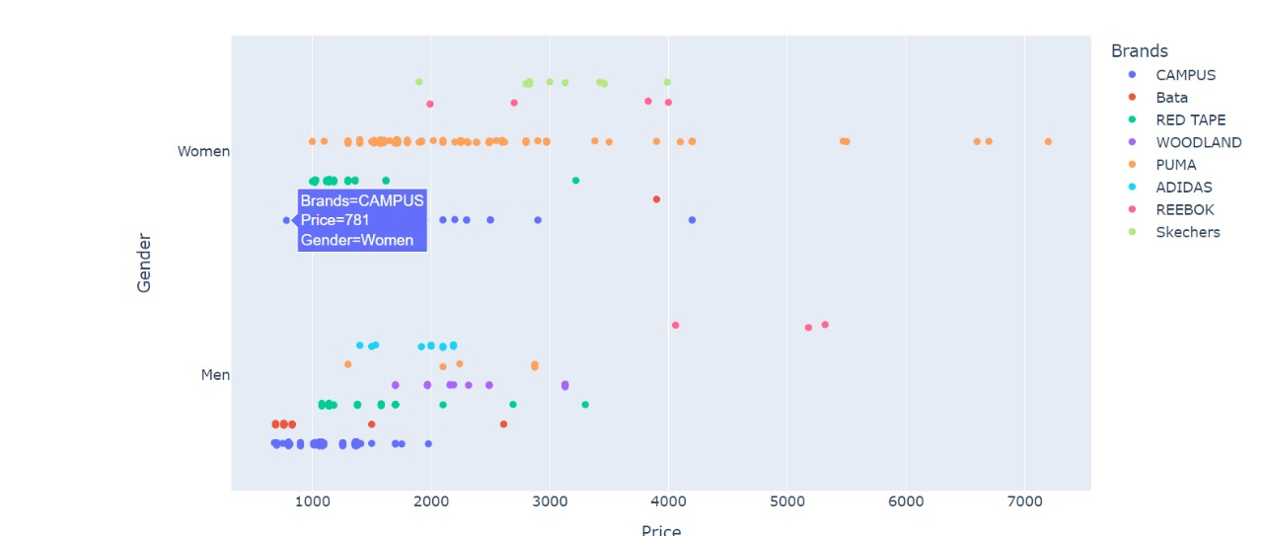
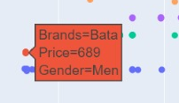
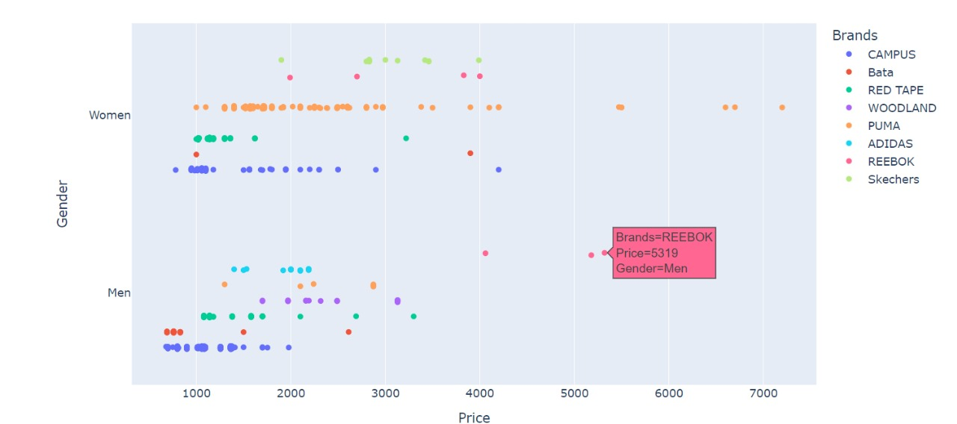
Range of prices for men and women in different brands

Slide 15
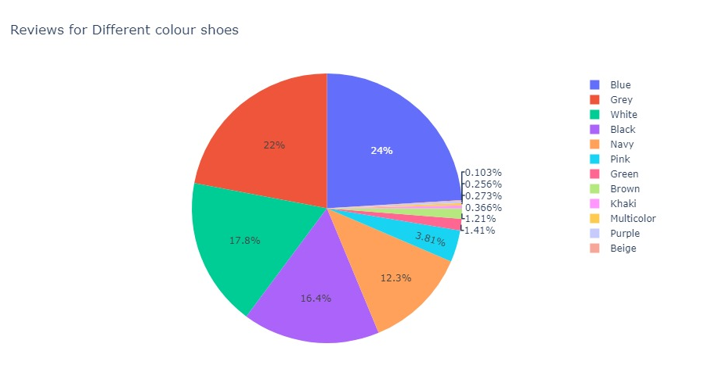
Percentage of reviews for different coloured shoes

Slide 16
Insights
The dataset unfolds a fierce competition among popular brands like Campus, Bata, Red Tape, Woodland, Puma, and Adidas, each competing for attention in the market.
Campus emerges as the highest of the dataset, with numerous appearances and a diverse range of products, almost like a superstar among others.

Slide 17
Reviews and ratings provide a glimpse into customer sentiments. Products with higher reviews may signify customer satisfaction or popularity, while those with fewer reviews might represent newer entries.
These insights provide a comprehensive overview of the market dynamics, consumer behaviours, and brand strategies present in the dataset.

Slide 18
Conclusion
In conclusion, the shoes classification data analysis has provided us with valuable insights into consumer preferences, demographic trends, and critical factors influencing purchasing decisions.

Slide 19
THANK YOU
Rupesh Kumar
Prabhu charan
Email: contactus@gmail.com

